Slide 1

Information and Network Security
Access Control -2
Notes:
This template can be used as a starter file for presenting training materials in a group setting.
Sections
Right-click on a slide to add sections. Sections can help to organize your slides or facilitate collaboration between multiple authors.
Notes
Use the Notes section for delivery notes or to provide additional details for the audience. View these notes in Presentation View during your presentation.
Keep in mind the font size (important for accessibility, visibility, videotaping, and online production)
Coordinated colors
Pay particular attention to the graphs, charts, and text boxes.
Consider that attendees will print in black and white or grayscale. Run a test print to make sure your colors work when printed in pure black and white and grayscale.
Graphics, tables, and graphs
Keep it simple: If possible, use consistent, non-distracting styles and colors.
Label all graphs and tables.

Slide 2
Access Control
Access Control Mechanisms
Rule based Access Control
Constrained User Interfaces
Access Control Matrix
Capabilities and ACL
Content and Context Based Access Control
Access Control Administration
Network Access Control
Firewalls
IDS
Single Sign-On Systems
Notes:
Give a brief overview of the presentation. Describe the major focus of the presentation and why it is important.
Introduce each of the major topics.
To provide a road map for the audience, you can repeat this Overview slide throughout the presentation, highlighting the particular topic you will discuss next.

Slide 3
Rule Based Access Control
uses specific rules that indicate what can and cannot happen between a subject and an object
based on the simple concept of “if X then Y” i.e propositional logic
Rule-based access control is NOT necessarily identity-based
Tom can use 5 MB attachments
Finance officer can use 6 MB attachments
Every user with secret clearance can use 5 MB attachments

Slide 4
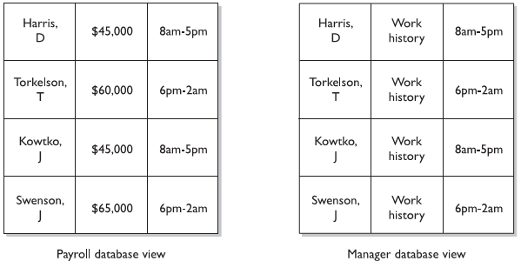
Constrained User Interfaces
Database Views
Restricted Shells
Physical Constraints (ATM)

Slide 5
Access Control Matrix
Table of subjects and objects indicating, what actions individual subjects can take upon individual objects
Usually an attribute of DAC models
The access rights can be assigned directly to the subjects (capabilities) or to the objects (ACLs)

Slide 6
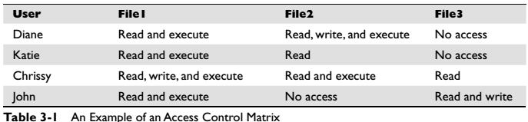
Access Control Matrix
Capabilities
specifies the access rights a certain subject possesses pertaining to specific objects.
corresponds to the subject’s row in the access control matrix
capability table bound to a subject
Capability can be in the form of a token, ticket, or key

Slide 7
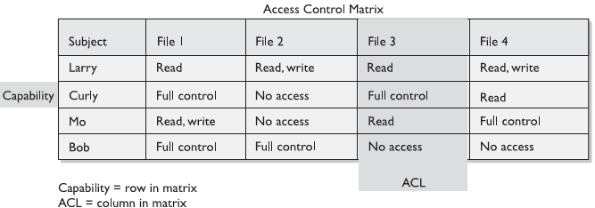
Access Control Matrix
Capabilities
specifies the list of subjects authorized to access a specific object
ACL corresponds to the object’s column in the access control matrix
ACL is bound to an object

Slide 8

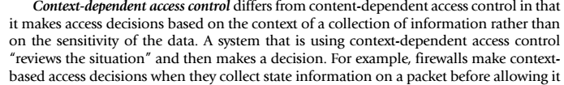
Content and Context based Access
Content dependent Access Control
Context dependent Access Control
Firewalls and Intrusion detection systems

Slide 9
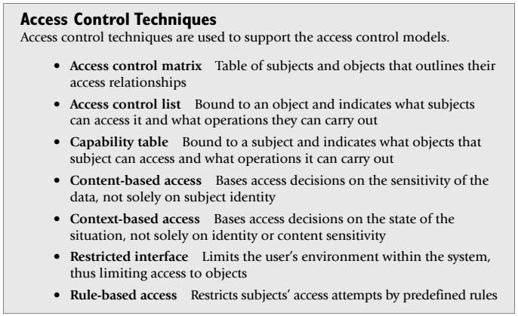
Summary

Slide 10
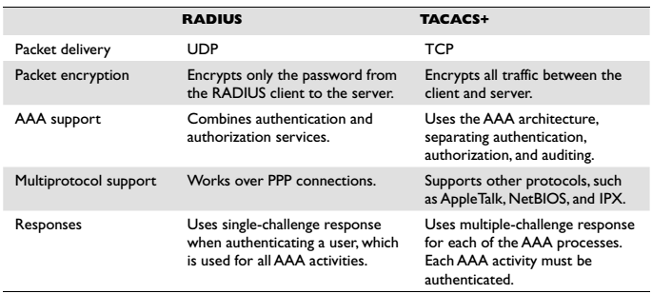
Access Control Administration

Slide 11
Non-repudiation
The goal of non-repudiation is to ensure undeniability of a transaction by any of the parties involved. A trusted third party, such as Trent, can be used to accomplish this.
For example, let us say Alice interacted with Bob at some point, and she does not want Bob to deny that she interacted with him. Alice wants to prove to some trusted third party (i.e., Trent) that she did communicate with Bob.

Slide 12
Non-repudiation
To summarize, trusted third parties can help conduct non-repudiable transactions.
In general, non-repudiation protocols in the world of security are used to ensure that two parties cannot deny that they interacted with each other.
In most non-repudiation protocols, as Alice and Bob interact, various sets of evidence, such as receipts, are generated.
The receipts can be digitally signed statements that can be shown to Trent to prove that a transaction took place.

Slide 13
Non-repudiation
Unfortunately, while non-repudiation protocols sound desirable in theory, they end up being very expensive to implement, and are not used often in practice.

Slide 14
Single Sign On Systems

Slide 15
KERBEROS
Provides a centralized authentication server to authenticate users to servers and servers to users.
Relies on conventional encryption, making no use of public-key encryption
Two versions: version 4 and 5
Version 4 makes use of DES

Slide 16
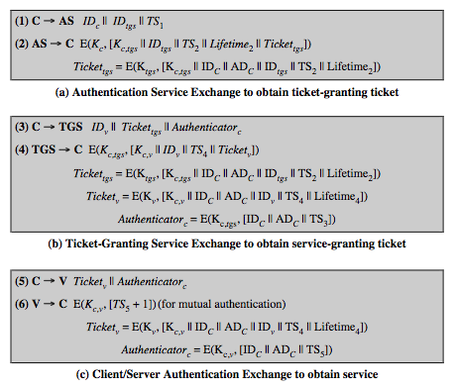
Kerberos v4 Dialogue
Notes:
The full Kerberos v4 authentication dialogue is shown here from Stallings Table 15.1, divided into 3 phases. The justification for each item in the messages is given in Stallings Table 4.1.
First, consider the problem of captured ticket-granting tickets and the need to determine that the ticket presenter is the same as the client for whom the ticket was issued. An efficient way of doing this is to use a session encryption key to secure information. Table 15.1a shows the technique for distributing the session key. Note that several additional pieces of information have been added to this first phase of the dialogue. Message (1) includes a timestamp, so that the AS knows that the message is timely. Message (2) includes several elements of the ticket in a form accessible to C. This enables C to confirm that this ticket is for the TGS and to learn its expiration time. Note that the ticket does not prove anyone's identity but is a way to distribute keys securely. It is the authenticator that proves the client's identity. Because the authenticator can be used only once and has a short lifetime, the threat of an opponent stealing both the ticket and the authenticator for presentation later is countered. C then sends the TGS a message that includes the ticket plus the ID of the requested service (message 3). The reply from the TGS, in message (4), follows the form of message (2). C now has a reusable service-granting ticket for V. When C presents this ticket, as shown in message (5), it also sends an authenticator. The server can decrypt the ticket, recover the session key, and decrypt the authenticator. If mutual authentication is required, the server can reply as shown in message (6)

Slide 17
Overview of Kerberos

Slide 18
Version 4 Authentication Dialogue
Problems:
Lifetime associated with the ticket-granting ticket
If too short  repeatedly asked for password
If too long  greater opportunity to replay
The threat is that an opponent will steal the ticket and use it before it expires

Slide 19
Difference Between Version 4 and 5
Encryption system dependence (V.4 DES)
Internet protocol dependence
Message byte ordering
Ticket lifetime
Authentication forwarding
Inter-realm authentication

Slide 20
Questions?

